Slide 1
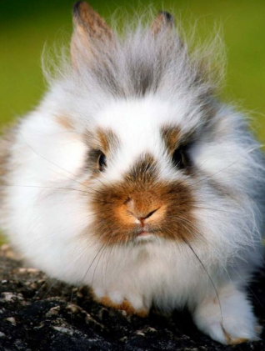
Rabbits

Slide 2
Big
Small
Click on the colored stars to start getting to know them!
Black
White
Fluffy
Tall
Short
Fast

Slide 3
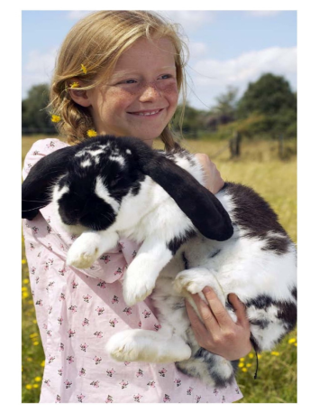
RETURN
This rabbit is big.

Slide 4
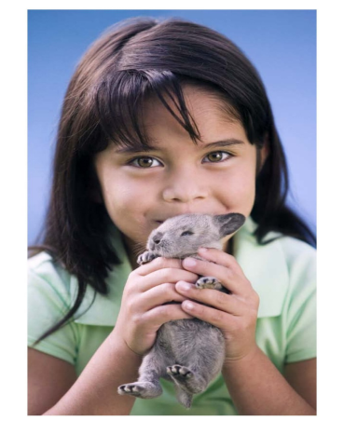
RETURN
This rabbit is small.

Slide 5
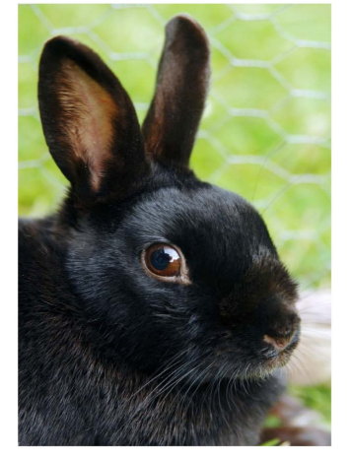
RETURN
This rabbit is black.

Slide 6
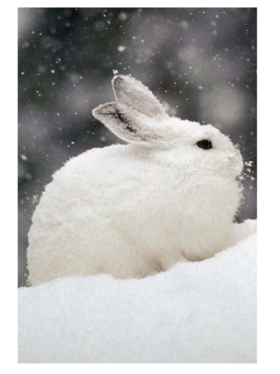
RETURN
This rabbit is white.

Slide 7
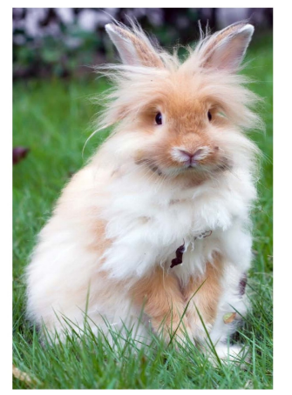
RETURN
This rabbit is fluffy.

Slide 8
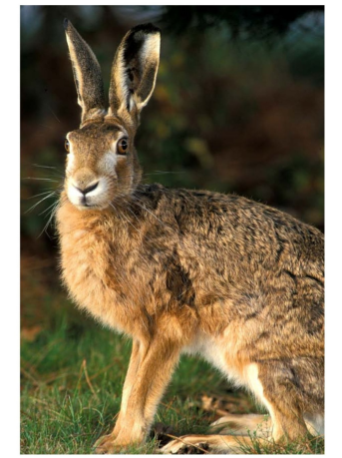
RETURN
This rabbit is tall.

Slide 9
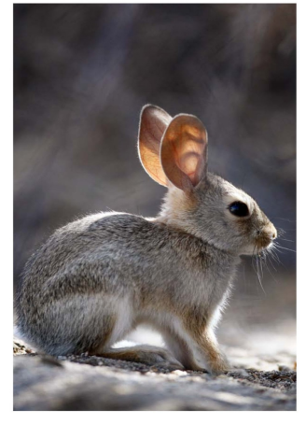
RETURN
This rabbit is short.

Slide 10
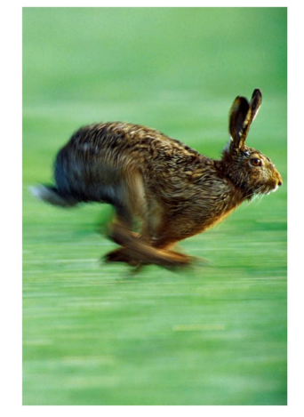
RETURN
This rabbit is fast.

